Slide 1
Satellite SAR ship detection using convolutional neural network
10/09/2019
Sanaz Salati
University Supervisors:
Olivier Dubrule, Lukas Mosser
Internship at CGG
Company Supervisor:
Harry McCormack

Slide 2
Table of contents
CGG project aims
SAR data
Method
Evaluation metrics and loss functions
Results
Conclusion
Future works

Slide 3
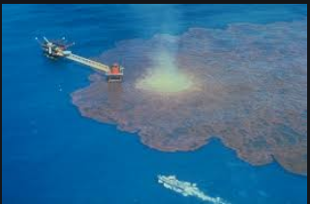
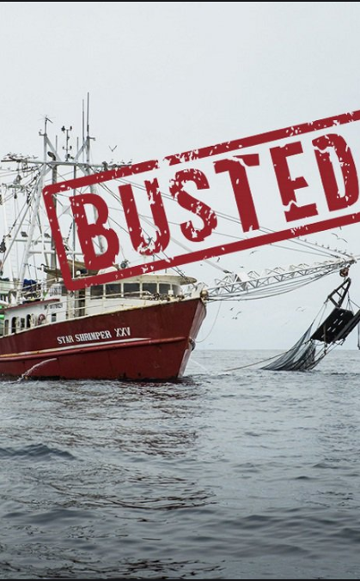
CGG services and products
Environmental Pollution
Ship detection using SAR data
Constant false alarm rate (CFAR) has been a common technique applied to achieve this goal so far
Illegal Fishing

Slide 4
CGG Research Project Aims
Using state-of-the-art machine learning techniques such as convolutional neural network (CNN)
Design and train CNN to process the SAR images and identify ship location
Comparing the output of CNN to CFAR to exploring the viability of CNN

Slide 5
Synthetic Aperture Radar (SAR) data
A form of radar collected from aircraft or spacecraft sensors.
To create SAR images, successive pulses of radio waves are transmitted to illuminate a target scene.
Echo of each pulse is received and recorded with wavelengths of meter down to several millimetres.
Independent of flight altitude and weather conditions.
Day and night image capability.

Slide 6
Data Preparation
SAR pre-processing
Calibration of SAR
Terrain correction
Conversion from 32 bit to 16 bit unsigned
Selecting images based on two criteria; the proximity to ports and existing of visible ships
Creating tiles (512 x 512) and (256 x 256)
Creating bounding box (labels)
Constant False Alarm Rate (CFAR) was use to automatic ship labelling
Bounding boxes created from CFAR outputs (polygons indicating presence of ships)

Slide 7
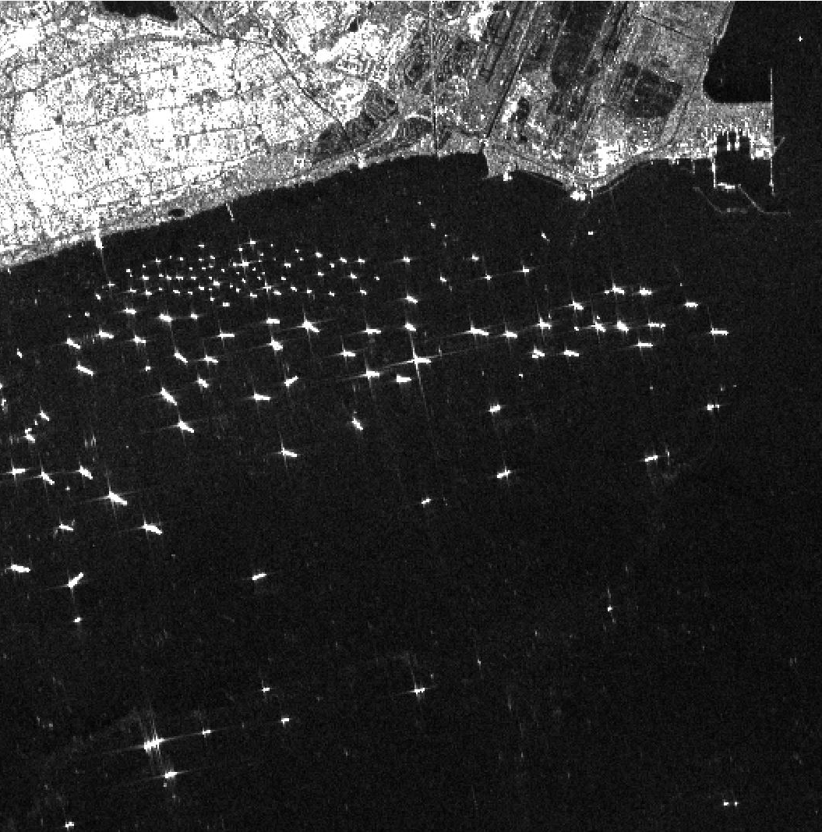
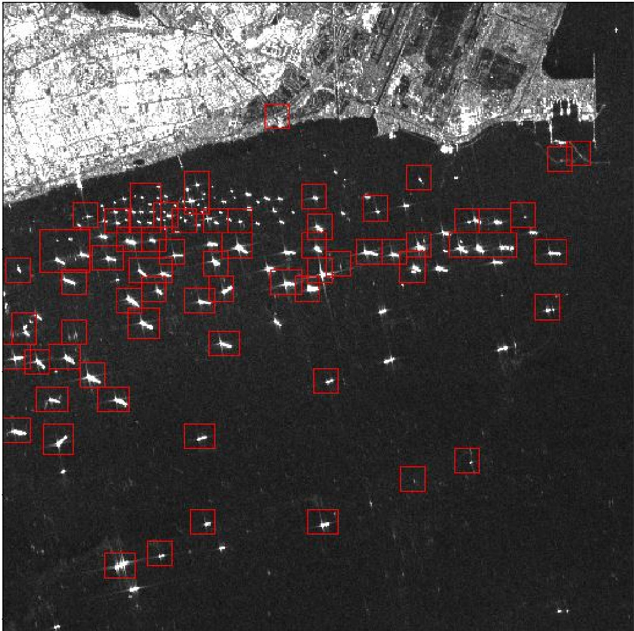
DATA
SAR images
SAR ship labels

Slide 8
Method
Object detection:
Classification
Localization (bounding box coordinates; x, y, w, h)
Why YOLOv3?
State of the art
Detecting at various scales
Detecting small objects
Feasibility for SAR ship detection

Slide 9
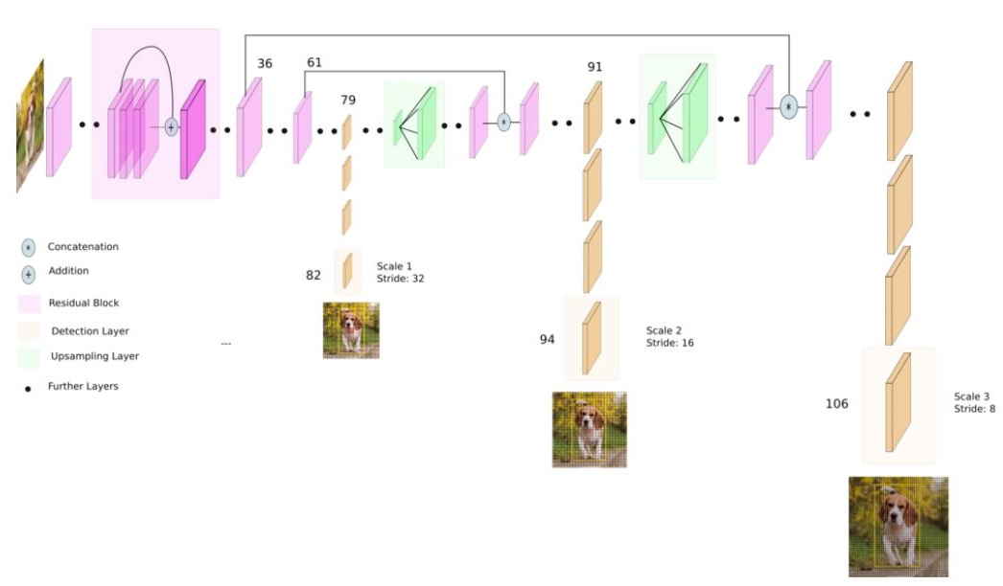
YOLOv3
(credit to Kathuria, 2018)

Slide 10
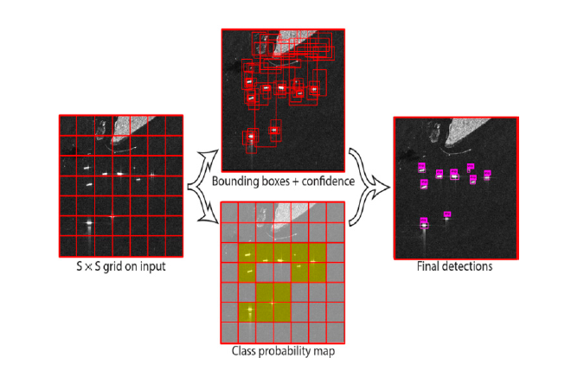
Chang et al, 2019

Slide 11
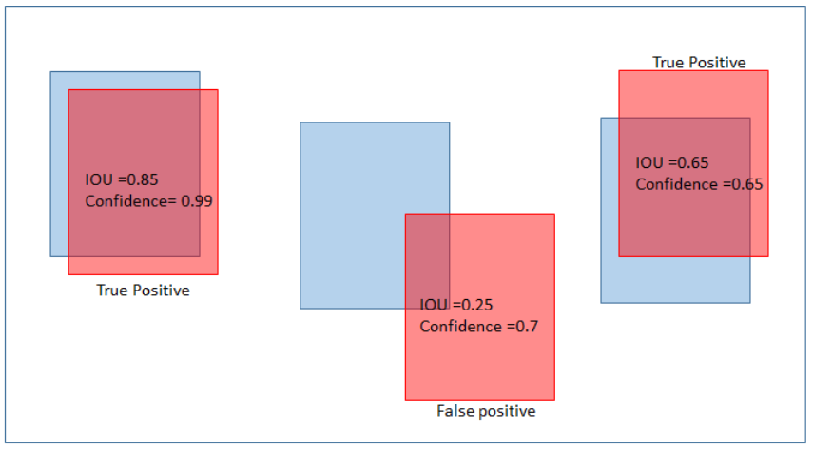
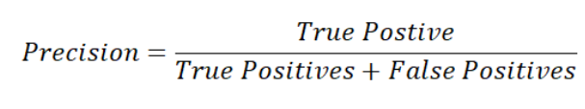
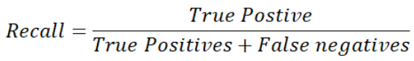
Evaluation metrics and loss function
Evaluation metric (on validation set):
Precision
Recall
Mean average precision (mAP)
F1
Loss functions (on training set)
GIoU
Classification
Objectivness (confidence)

Slide 12
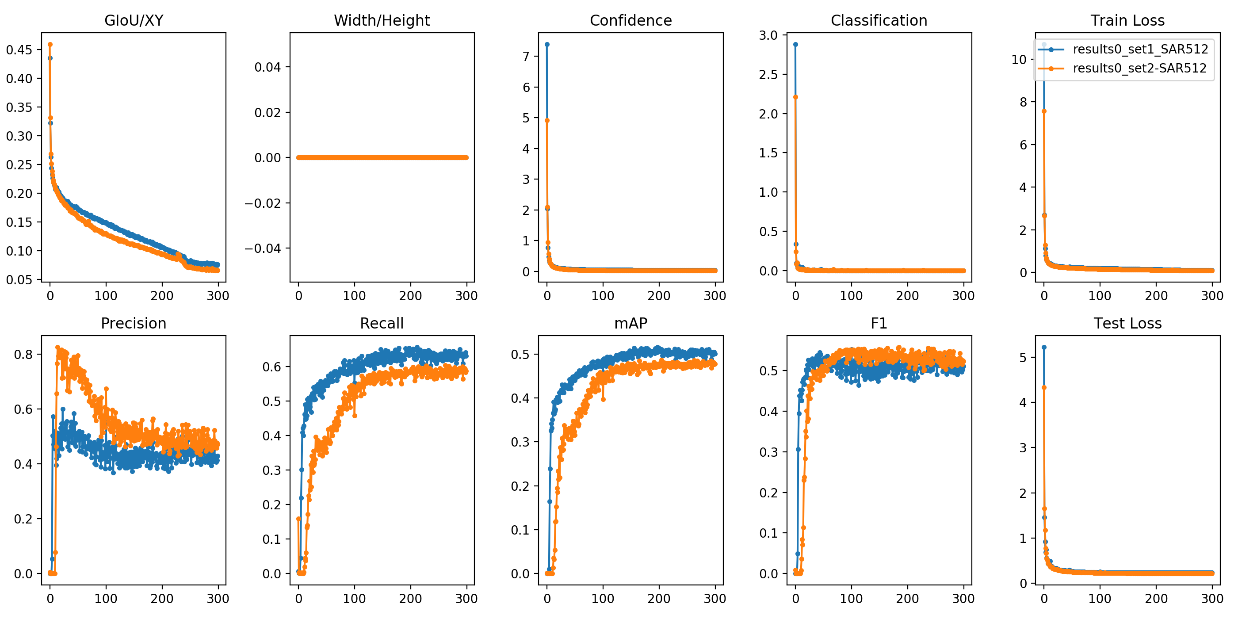
Results
Experiments with the image size of 512 x 512
Evaluation

Slide 13
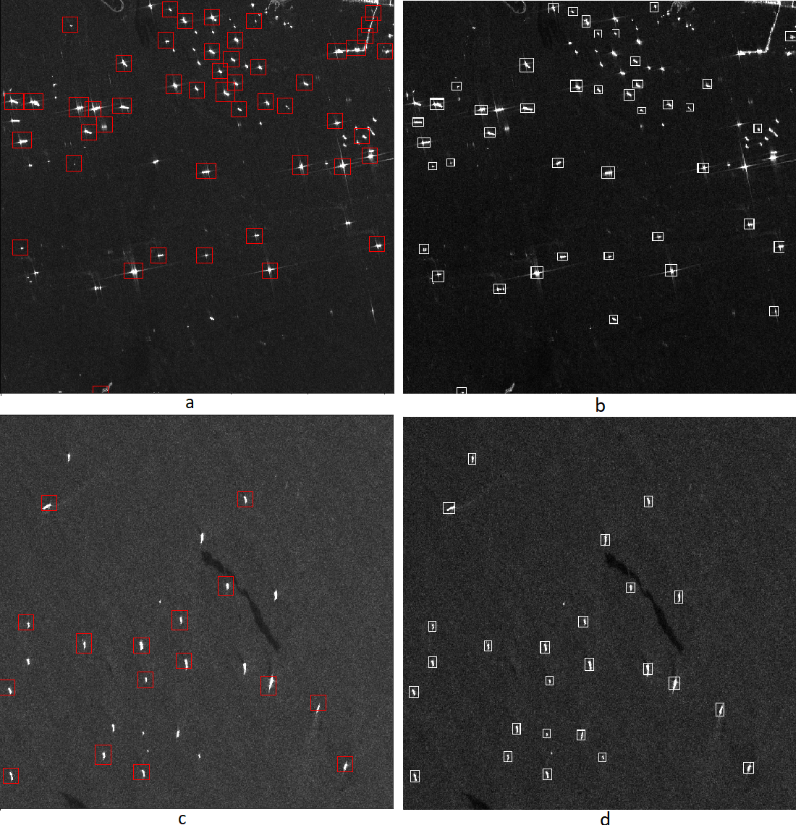
Ship detection in the sea using image size of 512 x 512
Left hand side illustrates SAR overlapped
with labels and right hand side shows
detection results

Slide 14
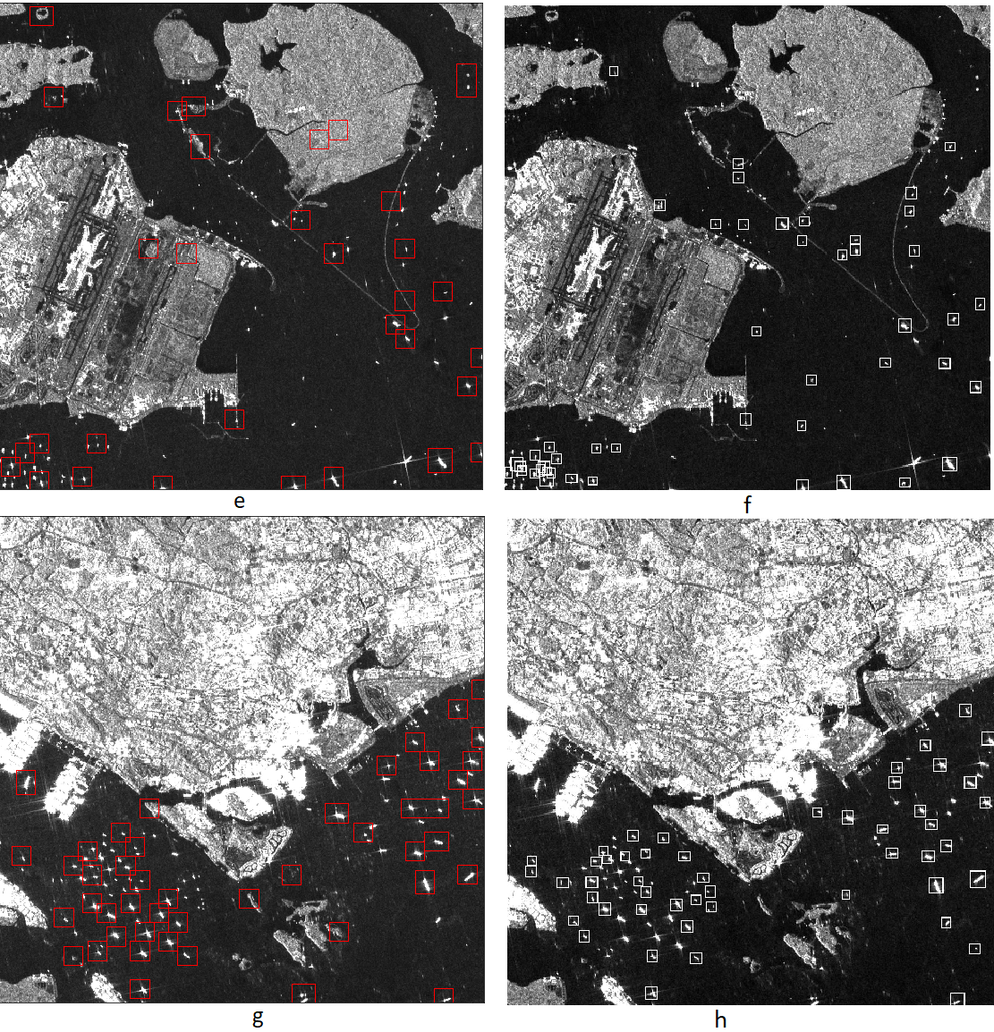
Ship detection in the coastal area using image size of 512 x 512
Left hand side illustrates SAR overlapped
with labels and right hand side shows
detection results

Slide 15
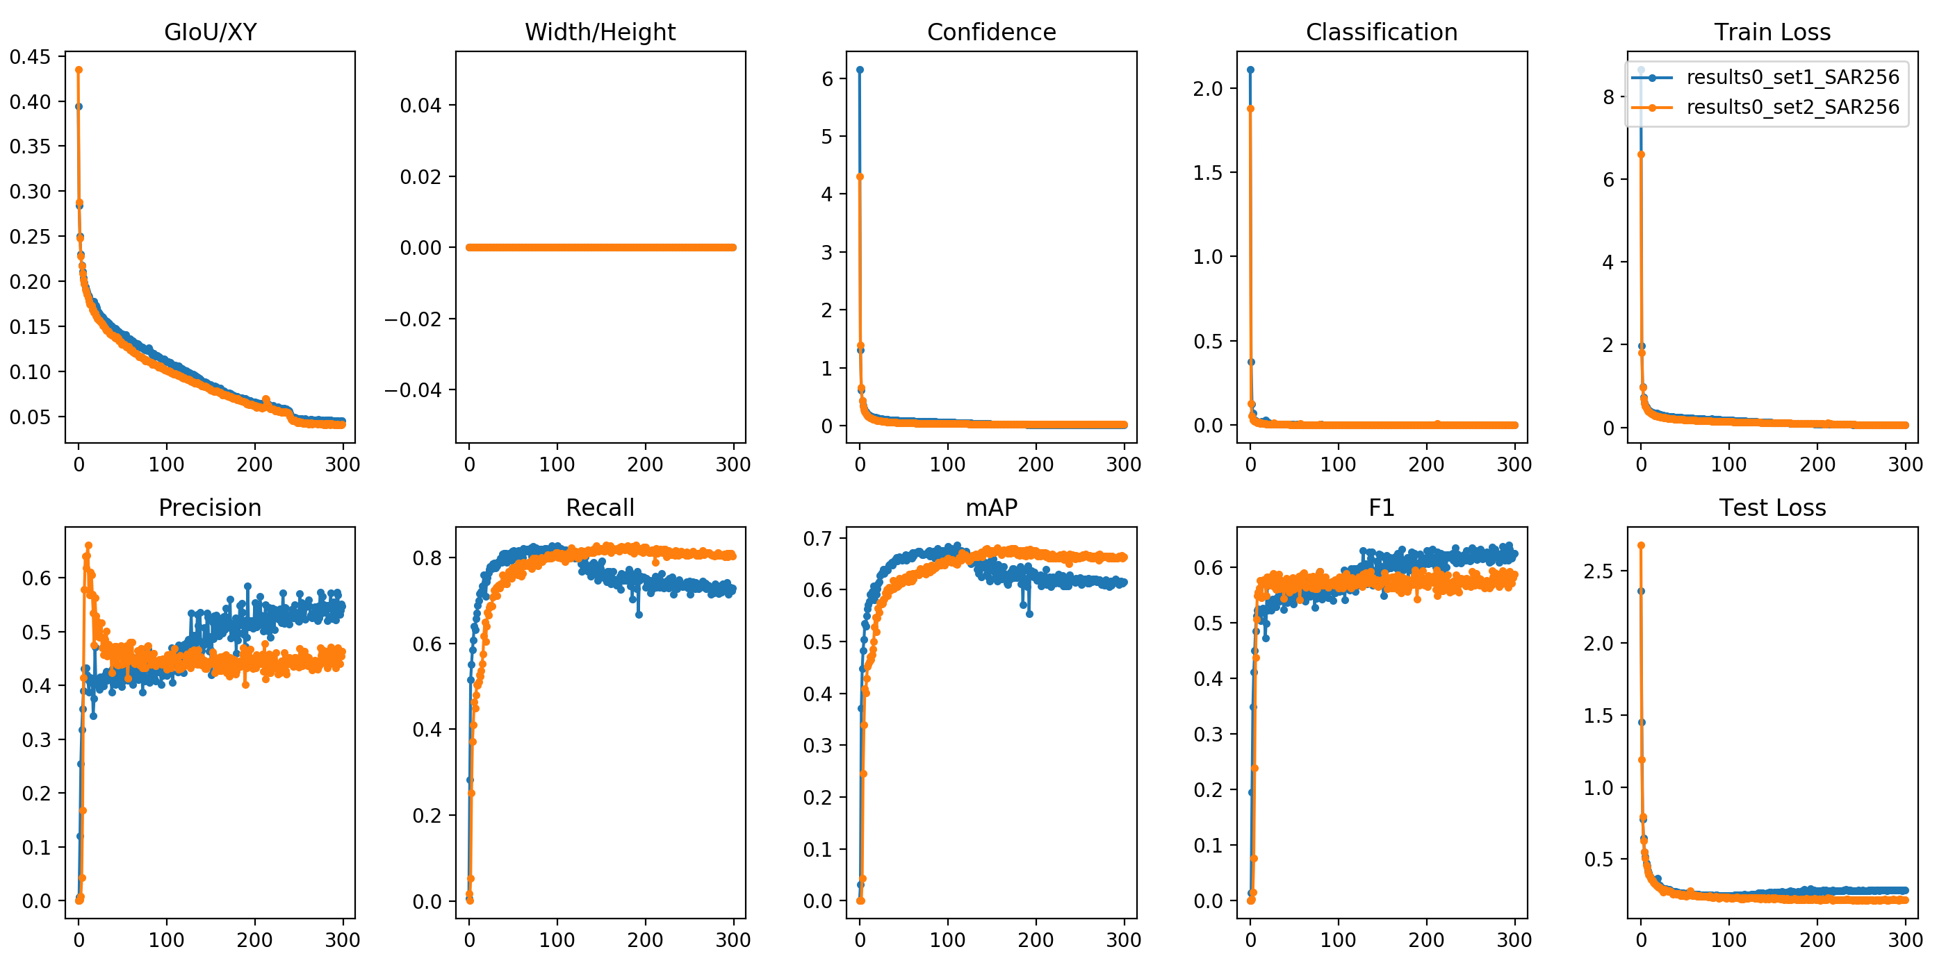
Experiments with the image size of 256 x 256

Slide 16
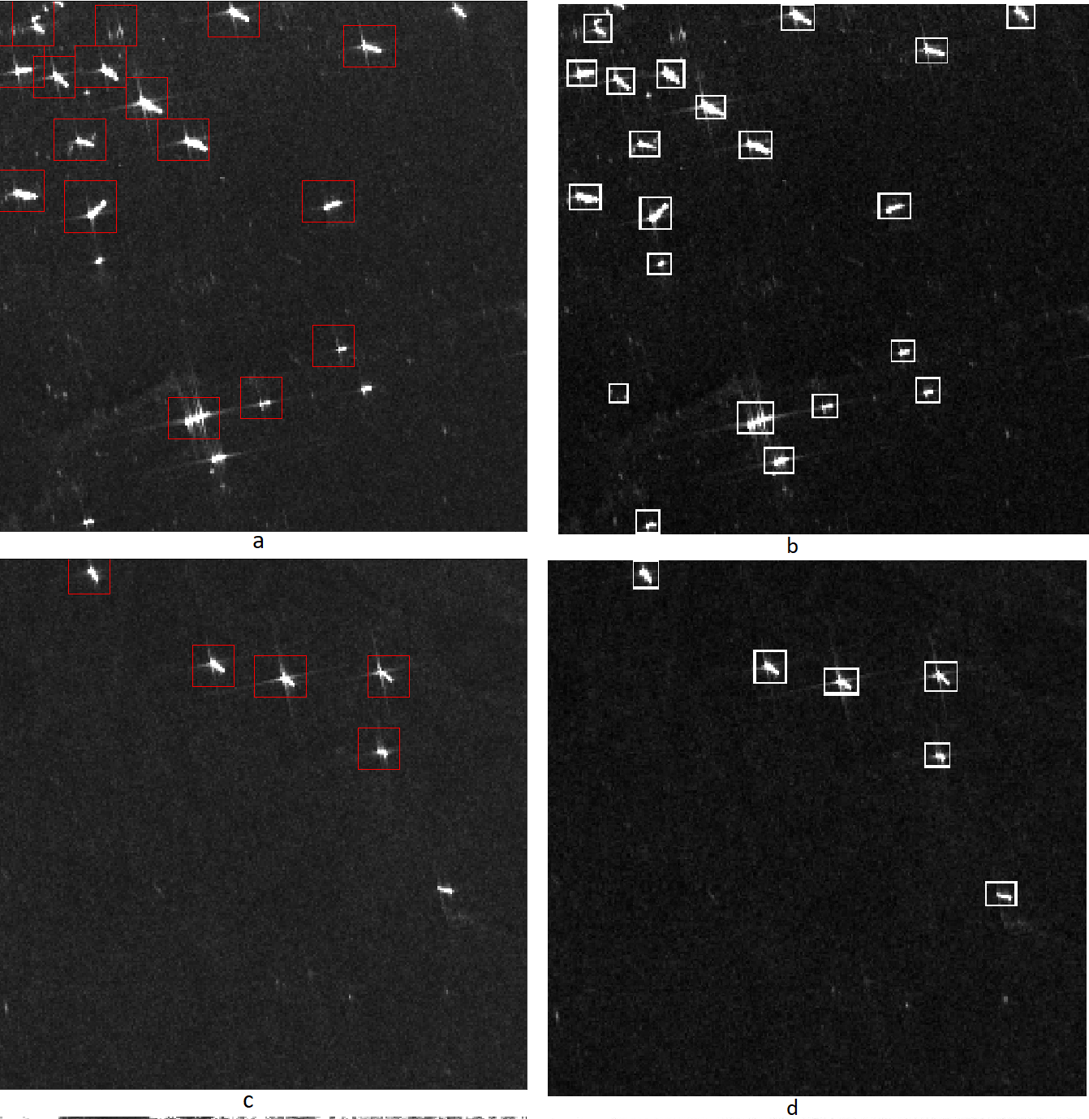
Ship detection in the sea using image size of 256 x 256
Left hand side illustrates SAR overlapped
with labels and right hand side shows
detection results

Slide 17
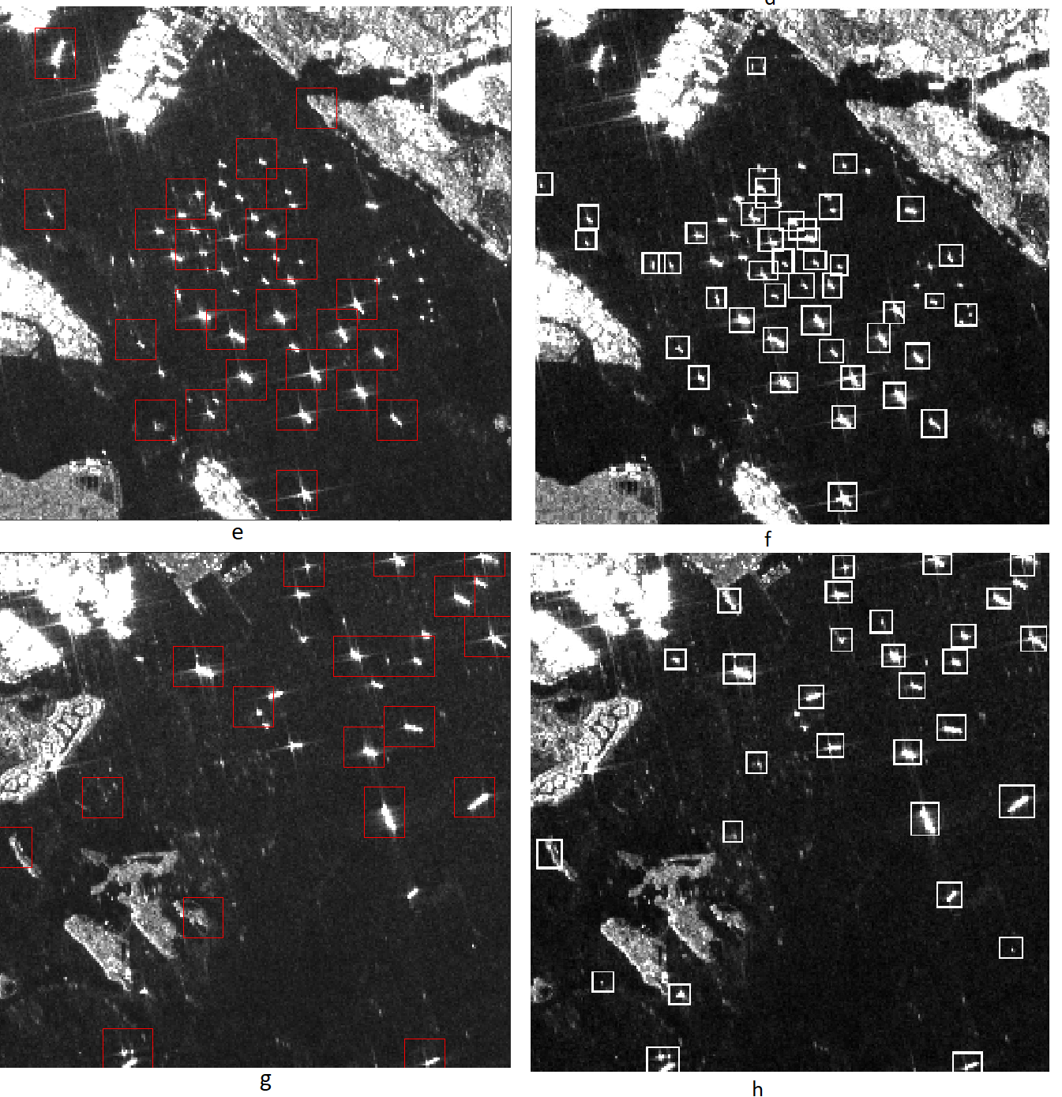
Ship detection in the coastal zone using image size of 256 x 256
Left hand side illustrates SAR overlapped
with labels and right hand side shows
detection results

Slide 18
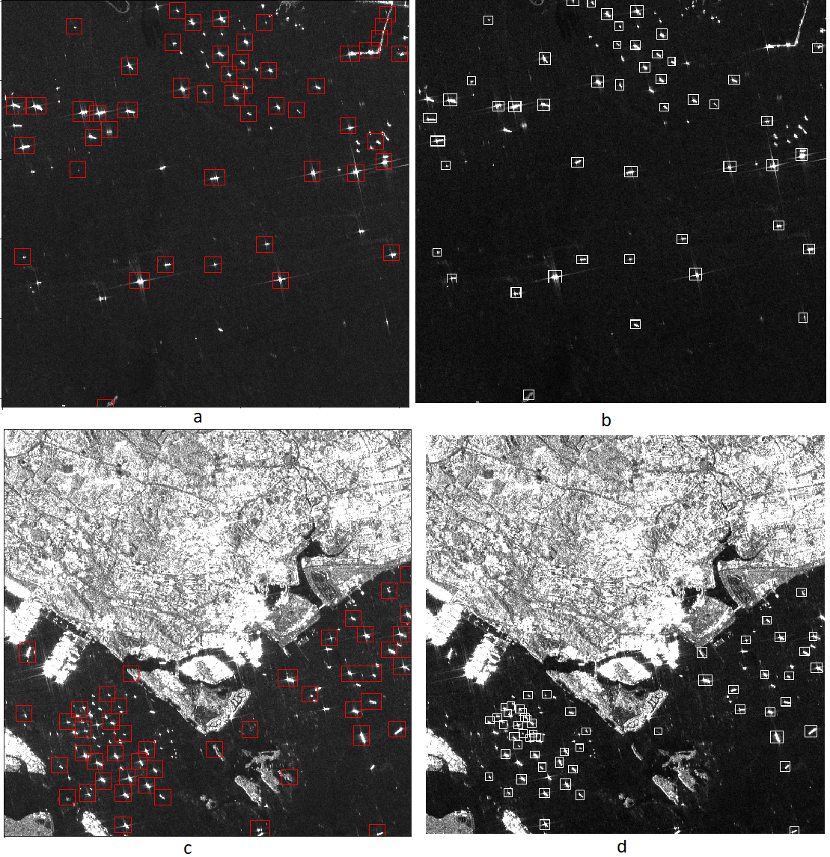
Experiments of SAR ship detection by initializing the model with dark-
net53.conv.74 weights
Ship detection using image size of 512 x 512
Left hand side illustrates SAR overlapped
with labels and right hand side shows
detection results

Slide 19
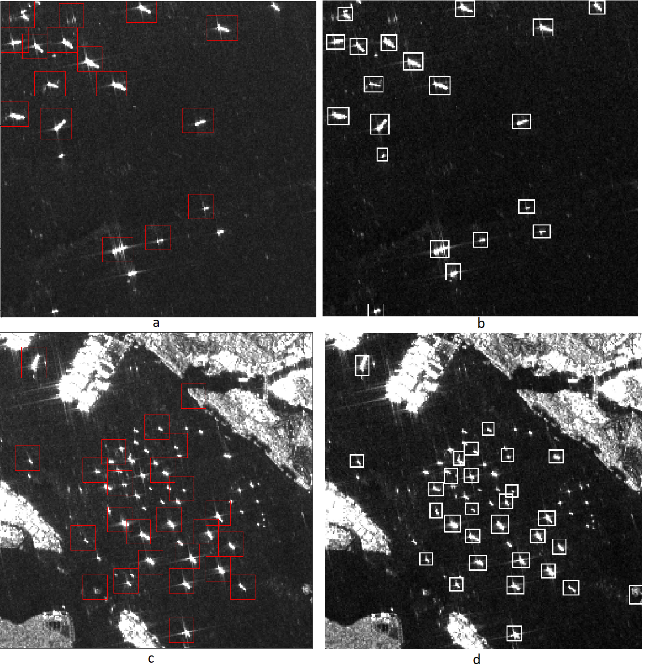
Experiments of SAR ship detection by initializing the model with dark-
net53.conv.74 weights
Ship detection using image size of 256 x 256
Left hand side illustrates SAR overlapped
with labels and right hand side shows
detection results

Slide 20
Conclusion
YOLOv3 is suitable for SAR image ship detection.
The experimental results on SAR images show that YOLOv3 method has some advantages over the CFAR method.
image size had a significant influence on the accuracy of the model.
Using image size of 256 x 256, YOLOv3 architecture return higher mAP values and a better detection accuracy.
Applying augmentation methods is not suitable for SAR ship detection.
We found that using the pre-trained weights for initializing the model returns higher accuracy (Figures 10 and 11) and a better ship localization.

Slide 21
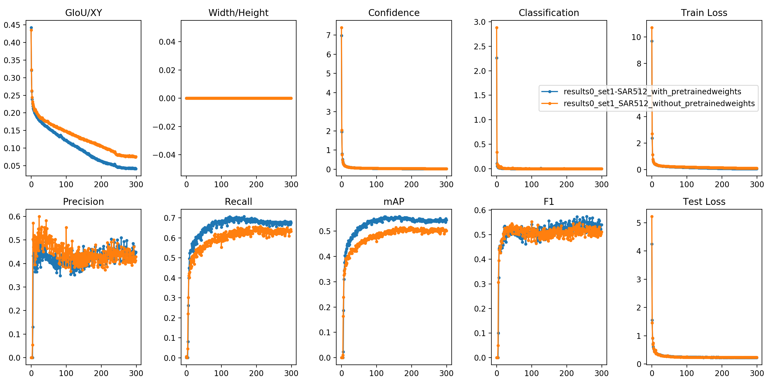
Comparison of training model from scratch with initializing model with pre-trained weights using image size of 512 x 512

Slide 22
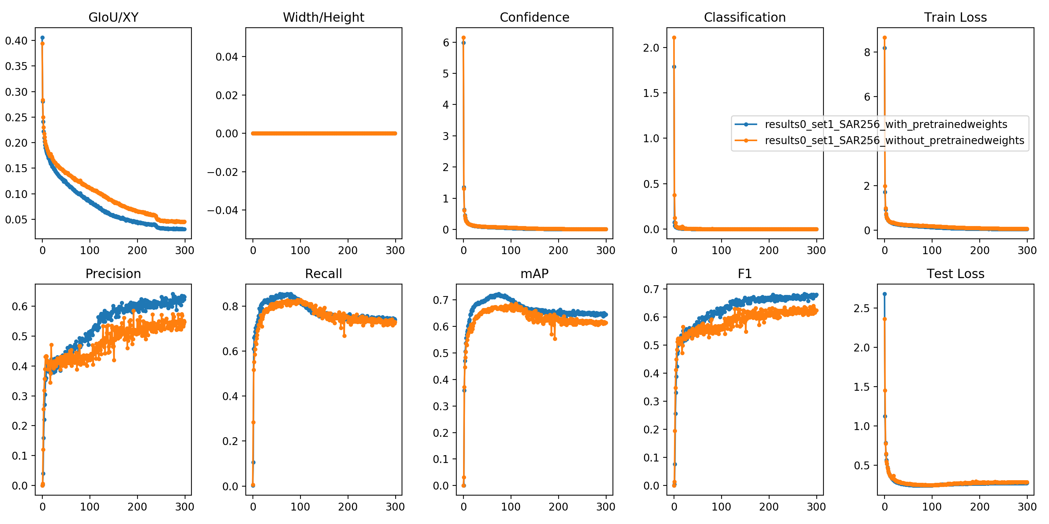
Comparison of training model from scratch with initializing model with pre-trained weights using image size of 256 x 256

Slide 23
Future work
Incorporating accurate labels and ancillary information into our ship localization system to obtain ship position with high certainty on SAR images.
Adding more images to the current dataset makes it larger and more robust results in generating more powerful models.

Slide 24
Thank you for your attention

